Slide 1
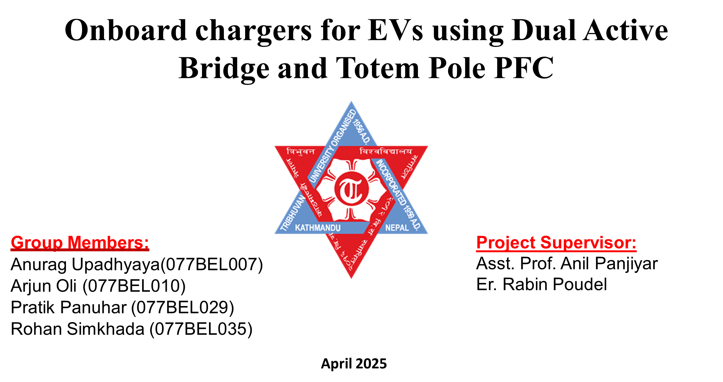
1

Slide 2
Table of Contents
Page
I
Introduction
3
II
Problem Statement
3
III
Project Objectives
7
IV
System Overview
7
V
Methodology
11
VI
Results and Discussions
13
VII
Conclusion
16
2

Slide 3
Introduction
Chapter I
Onboard chargers for EVs using Dual Active Bridge and Totem Pole PFC
3

Slide 4

I
Introduction
Electric Vehicles (EVs) are gaining popularity due to environmental concerns. Onboard charging systems are crucial for EV adoption and convenience. Our project focuses on developing an efficient onboard charging system.
4

Slide 5
Problem Statement
Chapter II
Onboard chargers for EVs using Dual Active Bridge and Totem Pole PFC
5

Slide 6
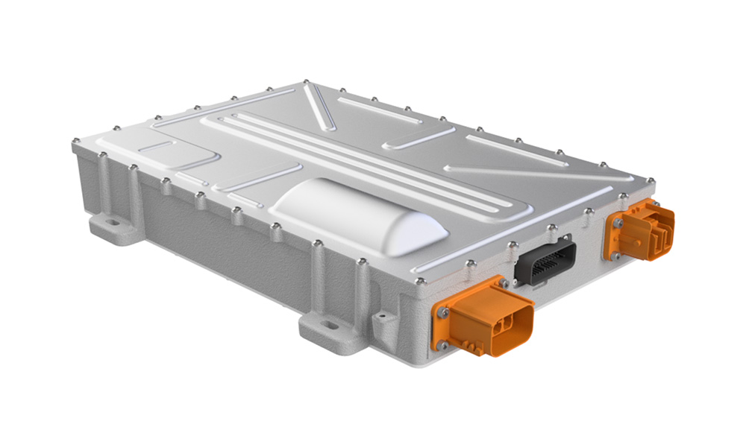
II
Problem Statement
Compact, effective, and reasonably priced on-board chargers are becoming more and more in demand as EVs become more widely used. Conventional isolated DC-DC converters can be large and inefficient, and boost-based PFC topologies suffer from higher conduction losses because of input bridge diodes.
6

Slide 7
Project Objectives
Chapter III
Onboard chargers for EVs using Dual Active Bridge and Totem Pole PFC
7

Slide 8
III
Project Objectives
1. To Facilitate Efficient Onboard Charging
Develop an efficient onboard charging system for EVs, optimizing charging speed and minimizing energy loss.
2. To Implement Totem Pole PFC
Implement and analyze Totem Pole Power Factor Correction (PFC) for AC-DC conversion, improving power efficiency and reducing harmonics.
3. To Design Dual Active Bridge Converter
Design a Dual Active Bridge (DAB) converter for DC-DC conversion.
8

Slide 9
System Overview
Chapter IV
Onboard chargers for EVs using Dual Active Bridge and Totem Pole PFC
9

Slide 10
IV
System Overview
Battery Pack
Stores energy for powering the electric motor.
Electric Motor
Converts electrical energy into mechanical energy to propel the vehicle.
Charging System
Manages the charging process, converting AC power to DC and regulating battery charging.
Thermal Management System
Regulates the temperature of the battery pack and other components to ensure optimal performance and safety.
AC-DC Converter
Converts grid AC power to DC power for battery charging.
Electric Vehicle Control Unit
Manages overall vehicle operation, including powertrain control, charging, and safety systems.
Filters
Reduce electromagnetic interference and noise in the system.
10

Slide 11
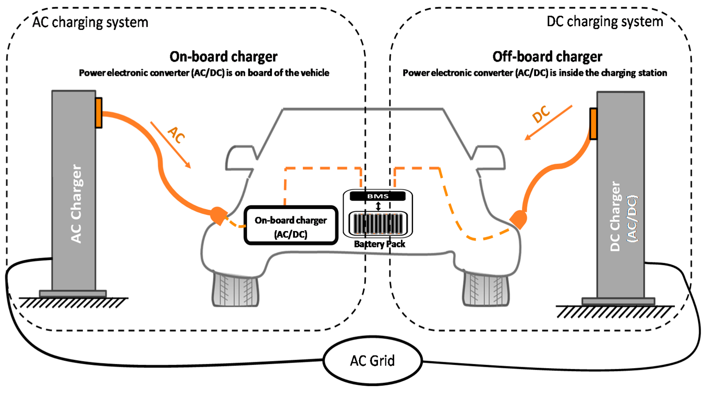
IV
System Overview
11

Slide 12
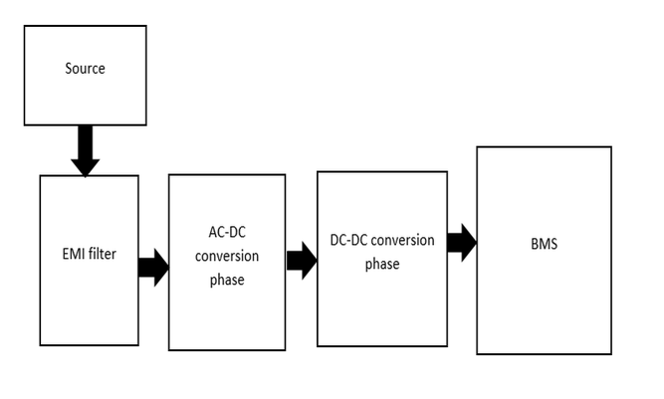
IV
System Overview
On board charging
A bridge between Electrical Vehicle Supply Equipment(EVSE) and the battery.
Converts alternating current available in the grid to direct current which charges the battery in the vehicle.
Critical component in electric vehicles (EVs), enabling them to charge their batteries from standard electrical outlets or dedicated charging stations.
12

Slide 13
IV
System Overview
AC-DC Conversion
Most electrical power from the grid is supplied as Alternating Current (AC).
Batteries and many electronic devices require Direct Current (DC) to operate.
AC-DC converters bridge this gap by transforming AC into usable DC power.
Essential for applications like:
Electric vehicle charging
Power supplies for electronics
Renewable energy systems
13

Slide 14
IV
System Overview
DC-DC Conversion
Convert the AC from the AC-DC phase and supplies the power to the battery system.
Various circuits maybe chosen for this purpose such as LLC resonant converter, Phase shifted full bridge converter and Dual Active Bridge converter
Essential requirement for this phase is to provide high efficiency, voltage stability and galvanic isolation.
14

Slide 15
Literature Review
Chapter IV
Onboard chargers for EVs using Dual Active Bridge and Totem Pole PFC
15

Slide 16
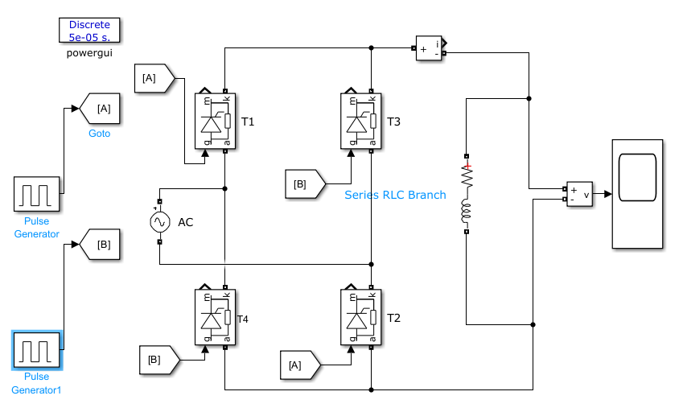
IV
Literature Review: AC-DC Conversion
Controlled Bridge Rectifier
Converts AC to controlled DC using thyristors.
Output regulated by adjusting firing angle.
Types: half-controlled and fully-controlled.
Used in motor drives, chargers, and power supplies.
Offers variable DC output and high efficiency.
16

Slide 17
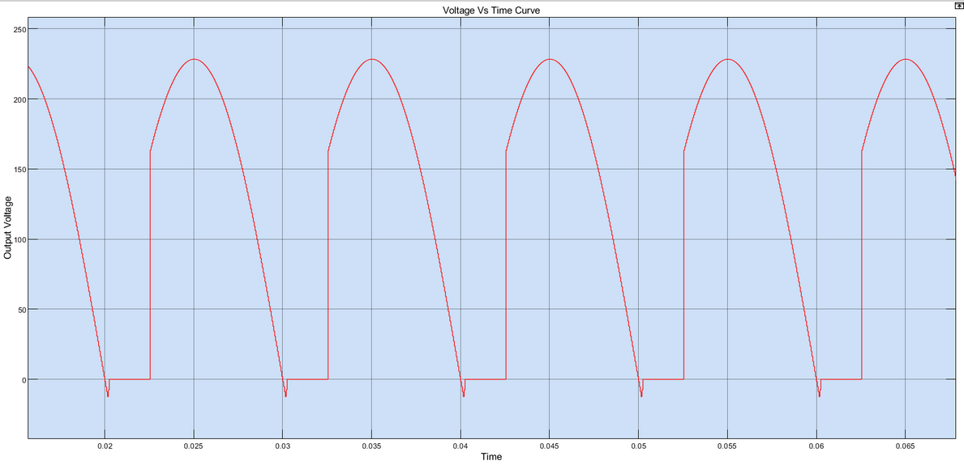
IV
Literature Review: AC-DC Conversion
Controlled Bridge Rectifier
Major Disadvantage: Pulsating DC Voltage
Pulsating DC causes inefficient charging, battery overheating, reduced battery life, and can damage sensitive battery chemistries.
17

Slide 18
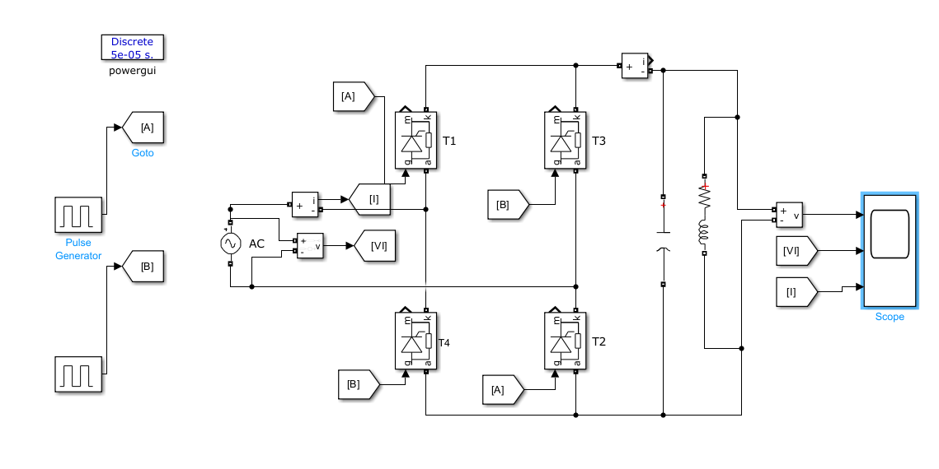
IV
System Overview: AC-DC Conversion
Controlled Bridge Rectifier with Capacitor
Capacitor smooths pulsating DC.
Provides steady output voltage.
Reduces ripple and heating.
Increases charging efficiency.
Lowers electromagnetic interference.
18

Slide 19
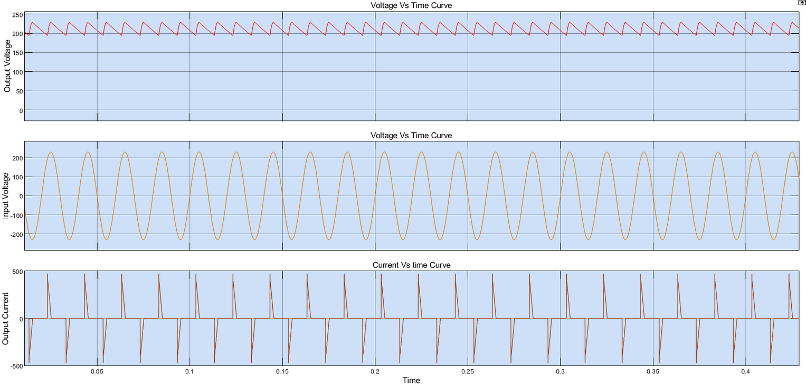
IV
System Overview: AC-DC Conversion
Controlled Bridge Rectifier with Capacitor
Major disadvantage: Capacitor-filtered controlled rectifiers have a poor power factor, especially at light loads.
Why: Current becomes highly peaky and out of phase with voltage, causing inefficient power use and stressing the AC supply.
19

Slide 20
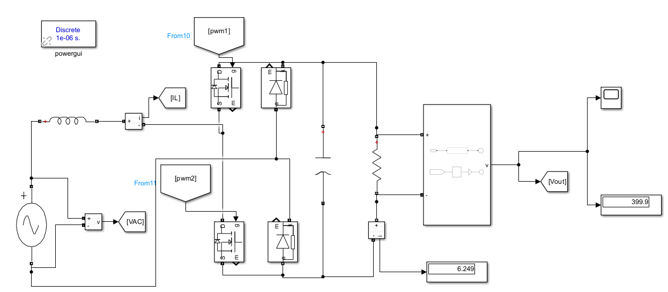
IV
System Overview: AC-DC Conversion
Totem Pole Power Factor Correction
Active switches in one leg, diodes in the other.
High efficiency, low losses.
Near-unity power factor.
Compact with fewer components.
Fast response to load changes.
20

Slide 21
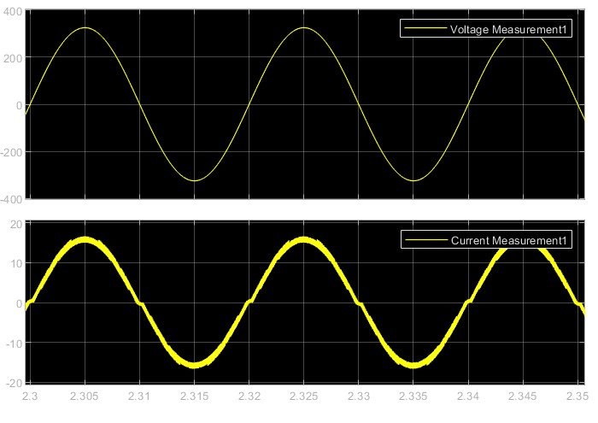
IV
System Overview: AC-DC Conversion
Totem Pole Power Factor Correction
Totem Pole PFC improves power factor by shaping the input current to closely match the input voltage. The waveforms show minimal phase difference and distortion, indicating high power factor and efficient AC-DC conversion.
21

Slide 22
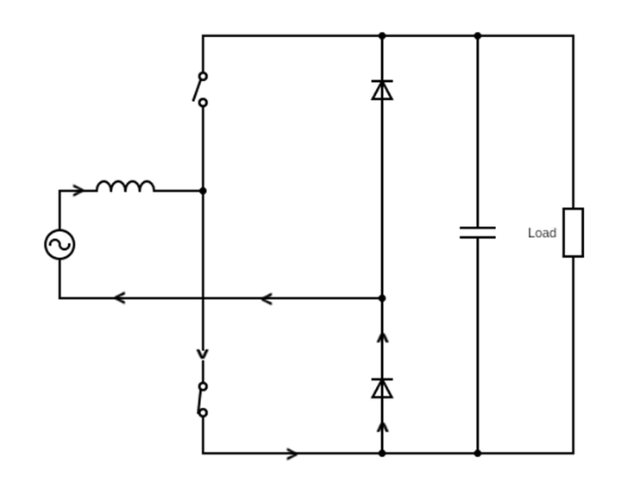
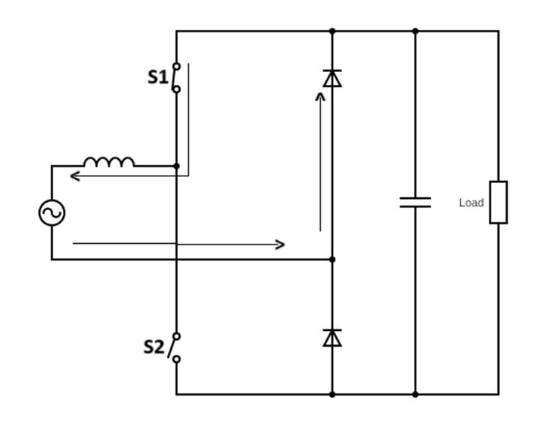
IV
System Overview: AC-DC Conversion
Totem Pole PFC: Operating Modes
Zero State Operation
In this state, the inductor is charged and the capacitor powers the load
22

Slide 23
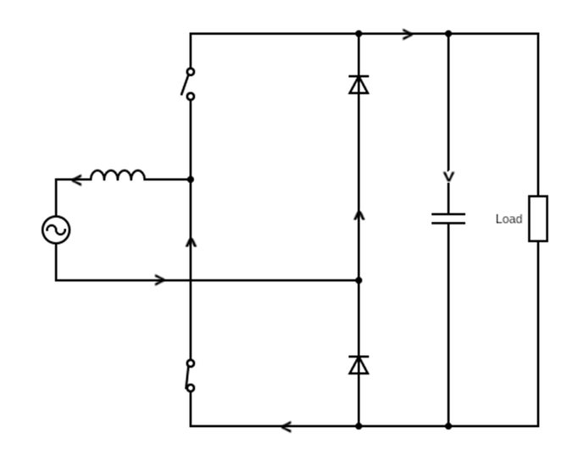
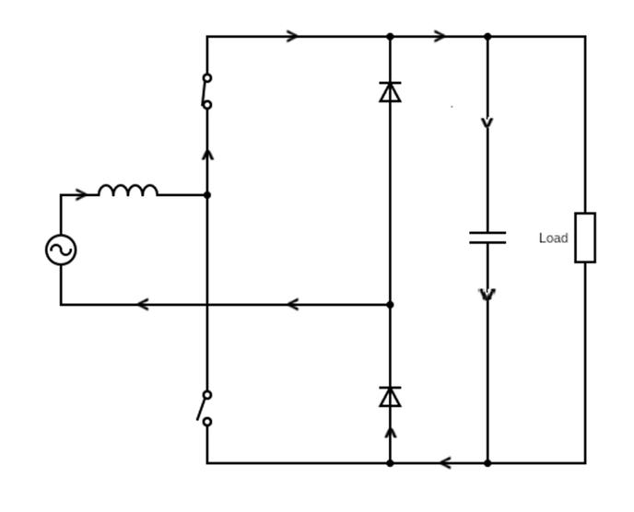
IV
System Overview: AC-DC Conversion
Totem Pole PFC: Operating Modes
Active State Operation
In this state, the Capacitor is charged and the inductor powers the load
23

Slide 24
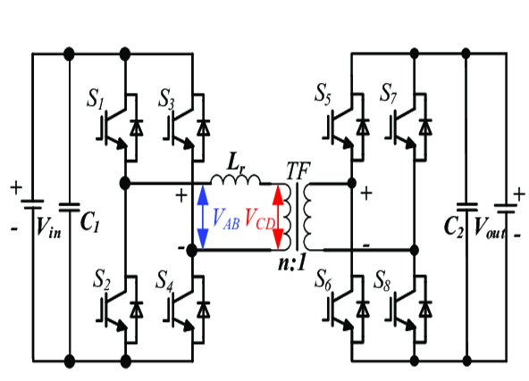
IV
System Overview: AC-DC Conversion
Dual Active Bridge Converter
Primary Side: The primary bridge converts the input DC voltage (from the AC-DC conversion stage) into
a high-frequency AC voltage.
Transformer: The high-frequency AC voltage is transferred through the transformer, which adjusts the voltage level based on the turns ratio.
Secondary side: The secondary bridge rectifies the high-frequency AC voltage back into DC voltage, suitable for charging the EV battery.
Phase Shift Strategies: In Dual Active Bridge (DAB) converters, power transfer is controlled by
adjusting the phase shifts between voltage waveforms
Source: www.alife-robotics.co.jp
24

Slide 25
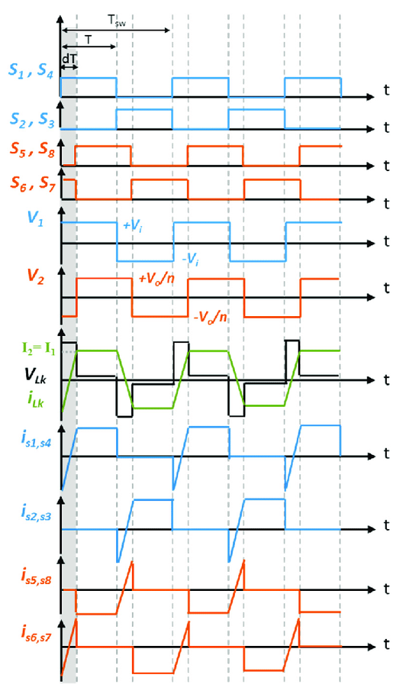
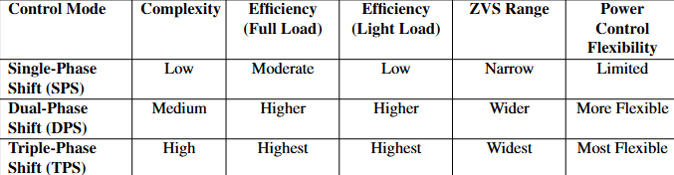
IV
System Overview: AC-DC Conversion
Dual Active Bridge Converter
Various control strategy are used for DAB and we have chosen single phase shift for its low complexity
S1,S4 are triggered at first, then at some angle phi S5 is triggered. This is the single phase shift control strategy.
Source: www.researchgate.net
25

Slide 26
Methodology
Chapter V
Onboard chargers for EVs using Dual Active Bridge and Totem Pole PFC
26

Slide 27
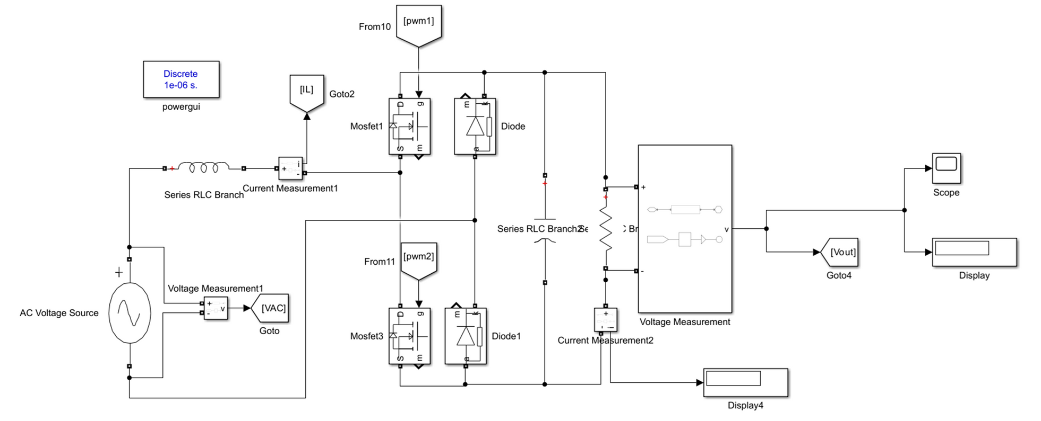
V
Methodology
Fig: SIMULINK Model for Totem Pole PFC Circuit
27

Slide 28
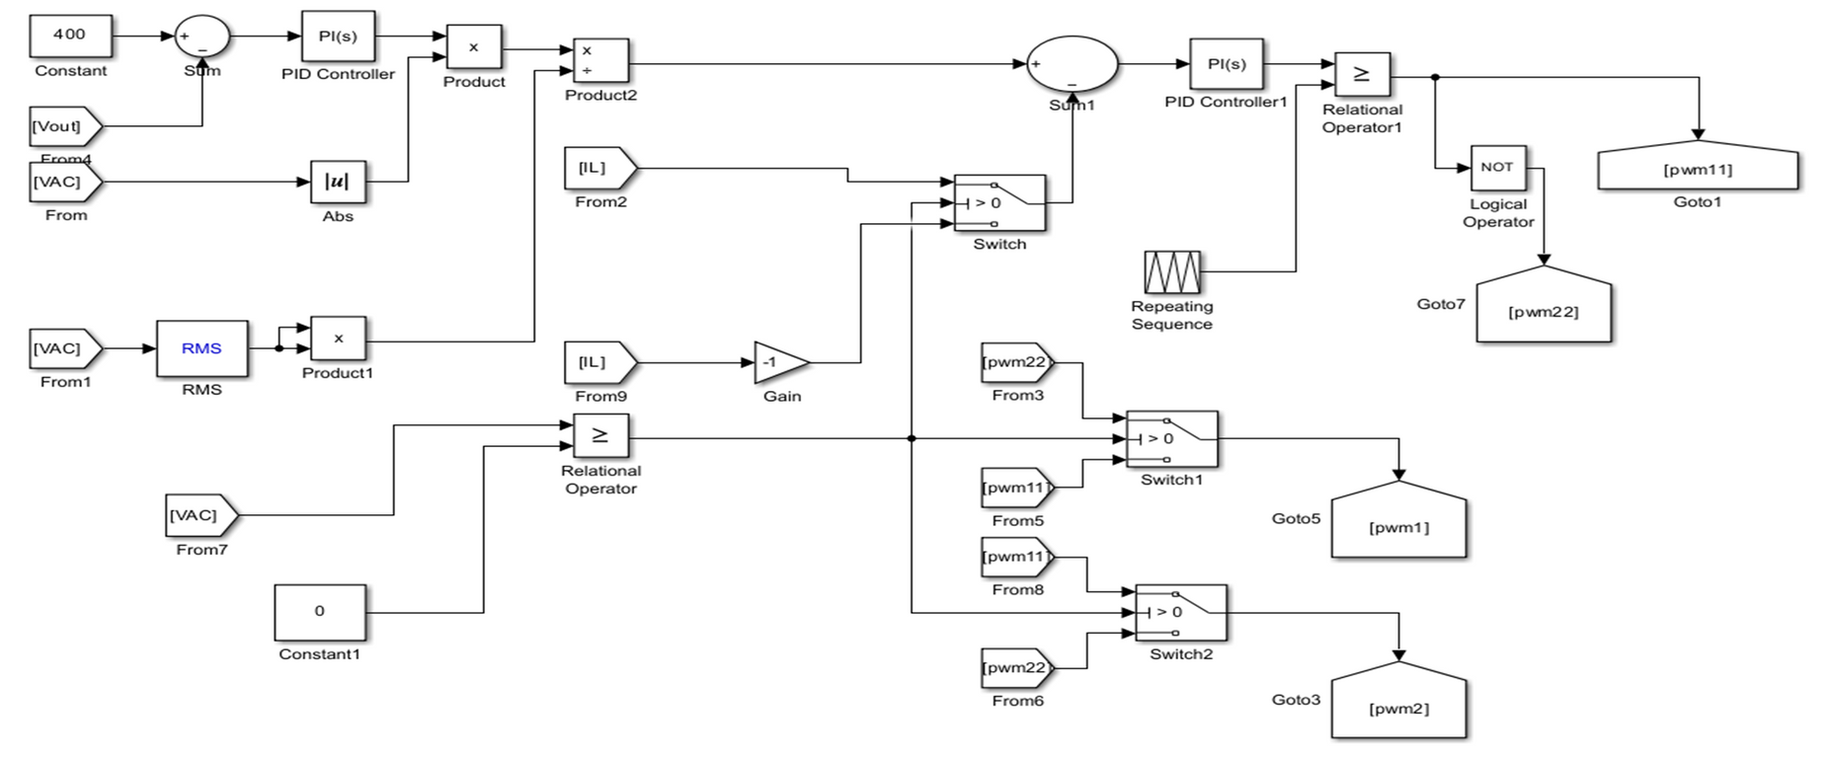
V
Methodology
28

Slide 29
V
Methodology
Calculation of individual parameter:
For totem pole pfc:
•Vin = 85–265 V
•Vout = 400 V
• Pout = 2–5 kW
•Fline = 50 Hz
•Fsw = 40 kHz
•Iripple = 0.3
•Vripple = 0.01
•IL = 2500 0.95×85 = 30.98
•Ipeak = IL × 1.30 = 30.98 × 1.3 = 40.27 A
• L = Vout/ 4×fsw×Iripple = 400 /4×40×10^3×0.3×43.78 = 1.903 × 10^-4 = 190.3 µH
•Cout = Pout / Vout 4π× Fline × Vripple = 2500 / 400 4Π × 400 × 0.01 × 50 = 2486.71 µF
29

Slide 30
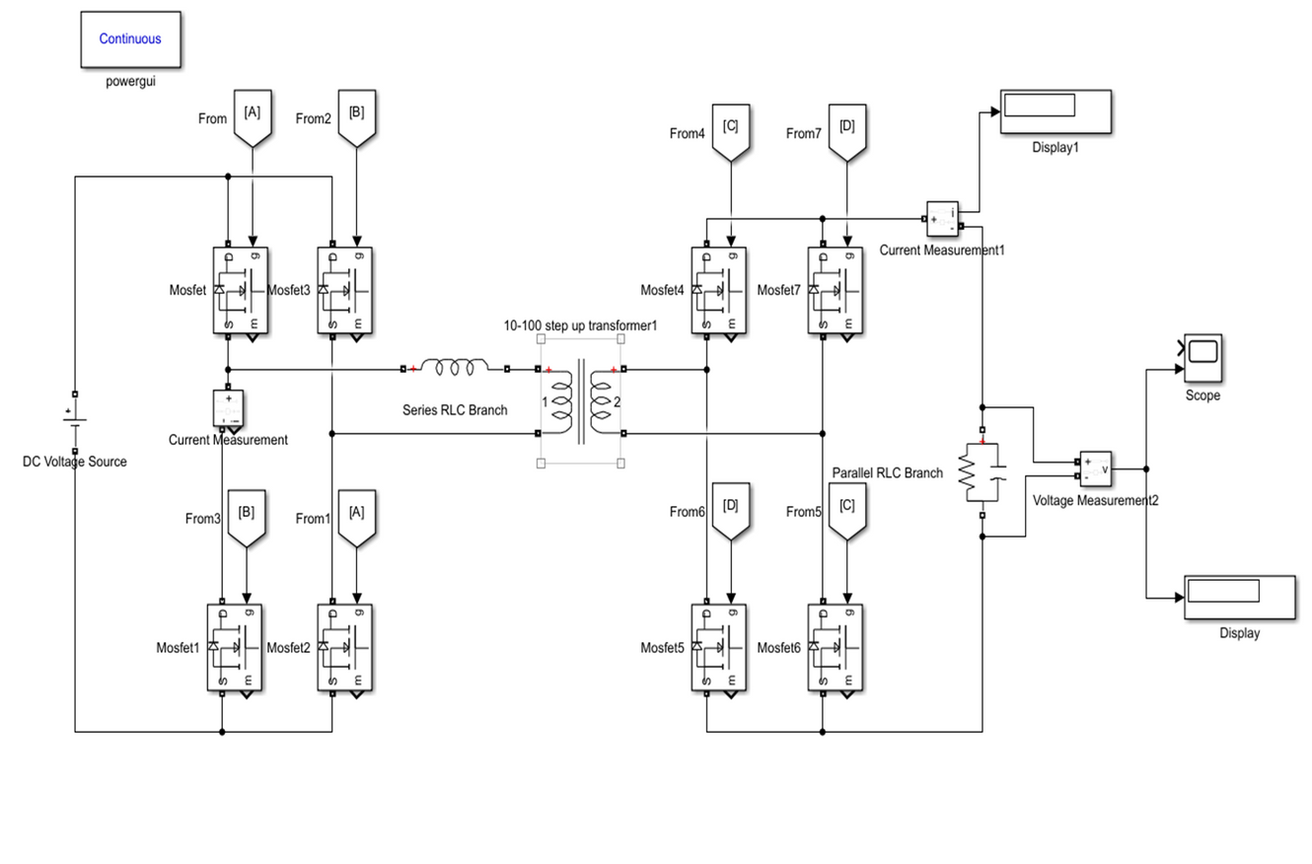
30

Slide 31
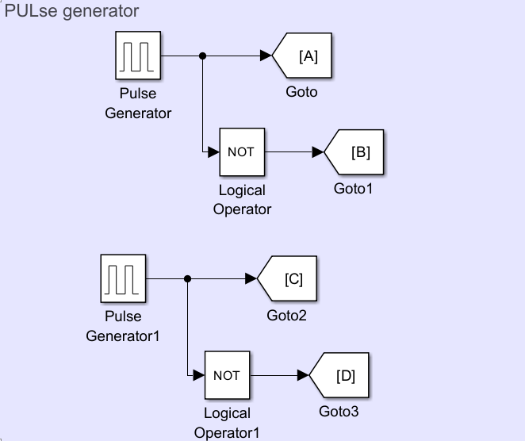
V
Methodology
For dab converters we have used two model where in the first model we have provided a manual phase shift in pulse generator
We know,
Po = Vi² · dΦ / Xl(1 – Φ / Π)
Po = 2500
Vi = 400
Put L = 0.3 × 10^-6 H
d = Vo / nVi
n = ½
For Vo = 200 V
Vi = 400 V
d = 2 × 200 / 400
d = 1
2500 = 400² / 2Π × f × 0.3 × 10^-6 · Φ(1 – Φ / Π)
Also, f = 500 kHz = 500 × 10³
2500 = 169765.2726 Φ(1 – Φ / Π)
0.0463 = ΠΦ – Φ²
Φ² – ΠΦ + 0.0463 = 0
Φ = 3.13 ,0.0148(in radian)
Φ =179.33, 0.85(in degree)
Since,-90<phi<90
So,
Φ=0.85
31

Slide 32
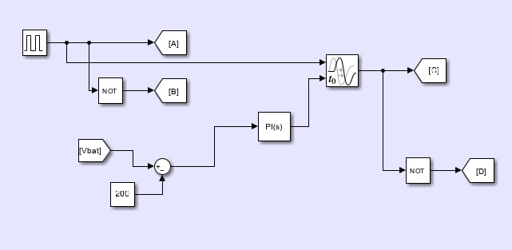
V
Methodology
Here we generate required phase shift from the difference between output voltage and constant value
32

Slide 33
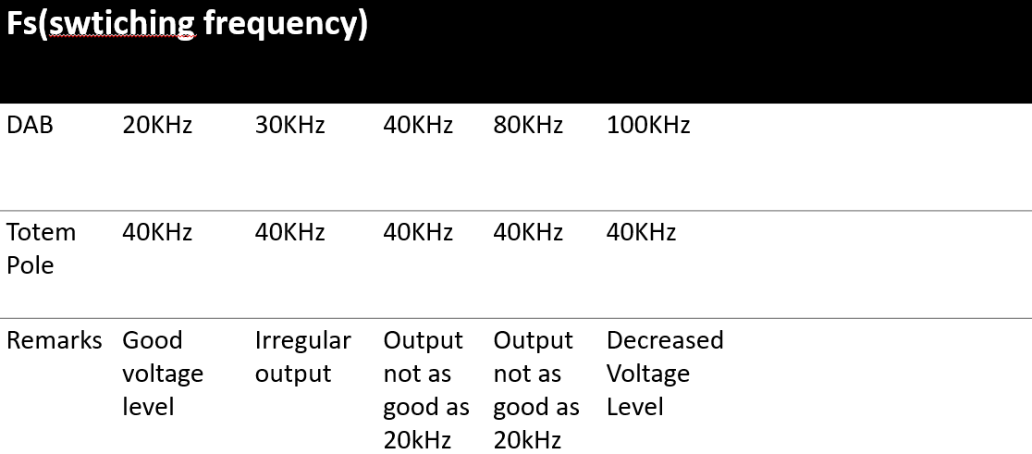
V
Methodology
Integration of AC/DC and DC/DC phase:
Note that above is for a constant phase shift
33

Slide 34
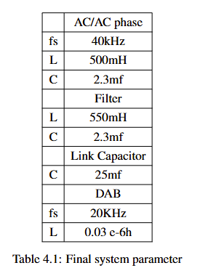
V
Methodology
Design of Filter and system parameters:
•We tried various values of L and C values to smooth out the circuit and finally settled for the following system parameter:
•Input Voltage=230V rms (AC)
•Output Voltage=200V DC
34

Slide 35
Result and Discussion:
Chapter VI
Onboard chargers for EVs using Dual Active Bridge and Totem Pole PFC
35

Slide 36
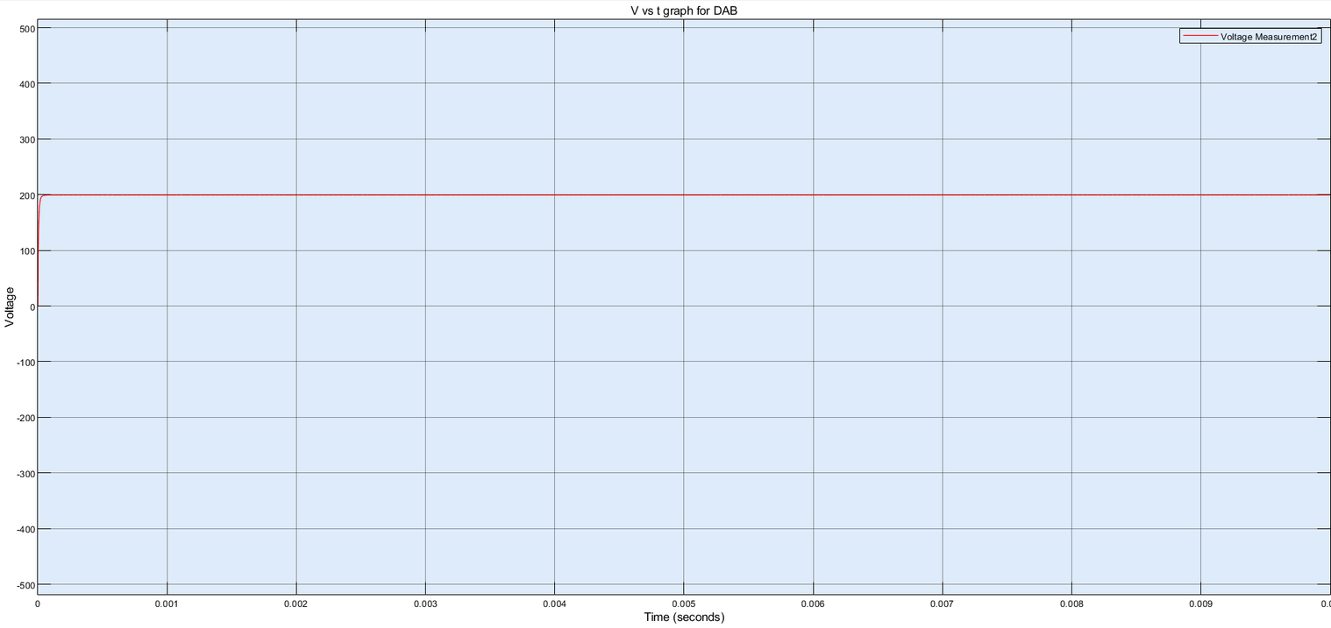
VI
Result and Discussion:
Output for individual circuits:
For dual active bridge converter with manual phase shift provided:
We can see a constant 200V which was obtained as desired
36

Slide 37
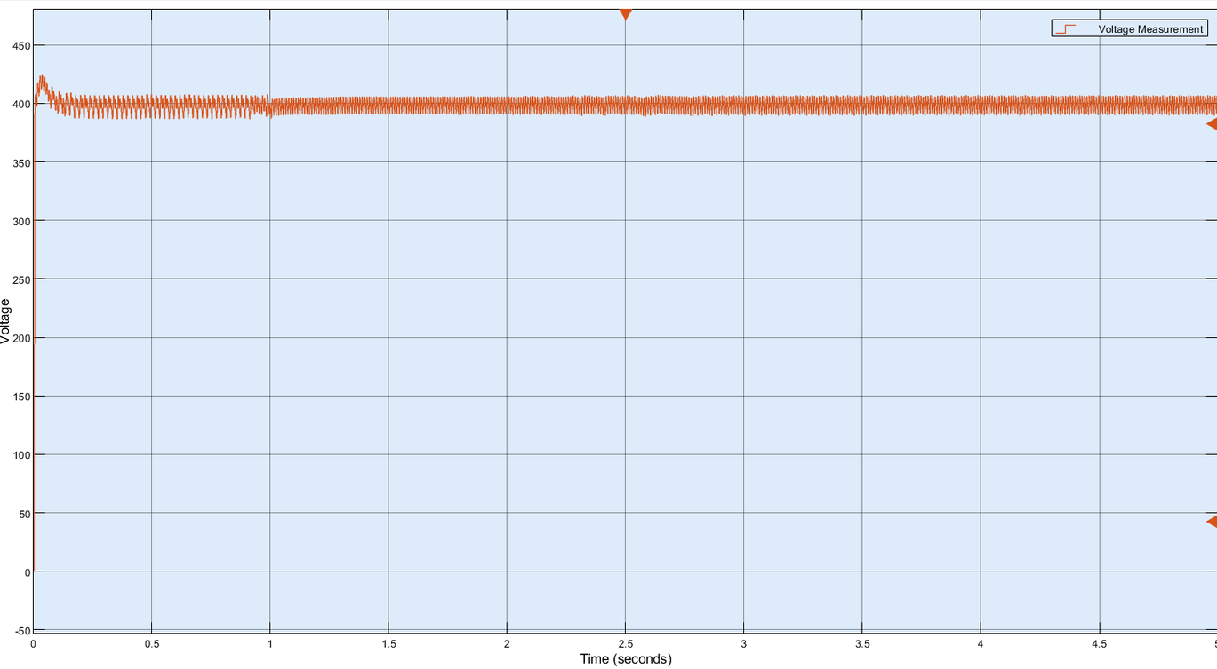
VI
Result and Discussion:
Output for individual circuits:
For totem pole pfc circuit:
37
We can see a voltage level with ripple oscillating near 400V which was the desired voltage level

Slide 38
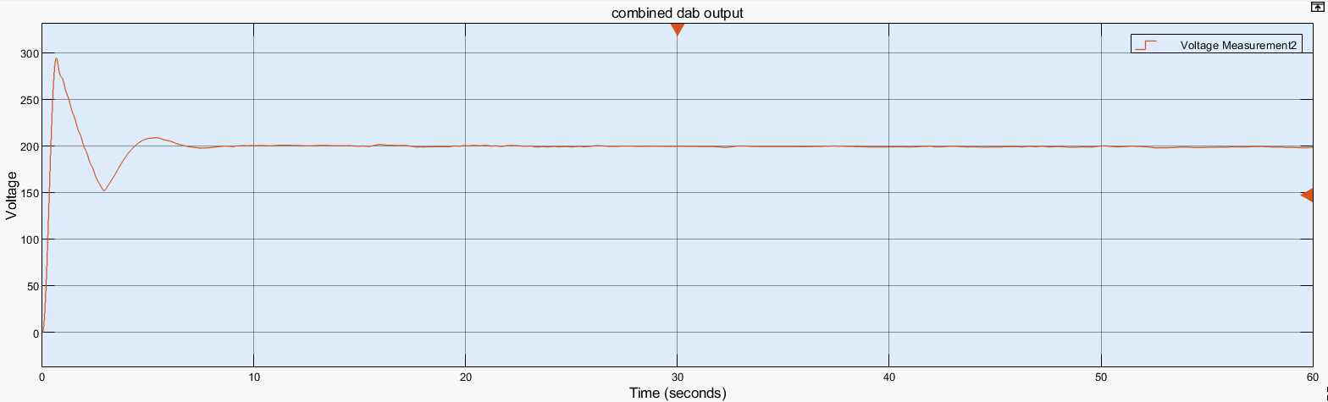
VI
Result and Discussion:
Output for combined circuits:
For the voltage output at the dual active bridge converter side:
Though we receive a constant voltage of 198.2 at the end of our simulation time which was T=60s which is efficient at 98% but we can see that this is for a limited simulation time and at higher simulation voltage decrease considerably.
38

Slide 39
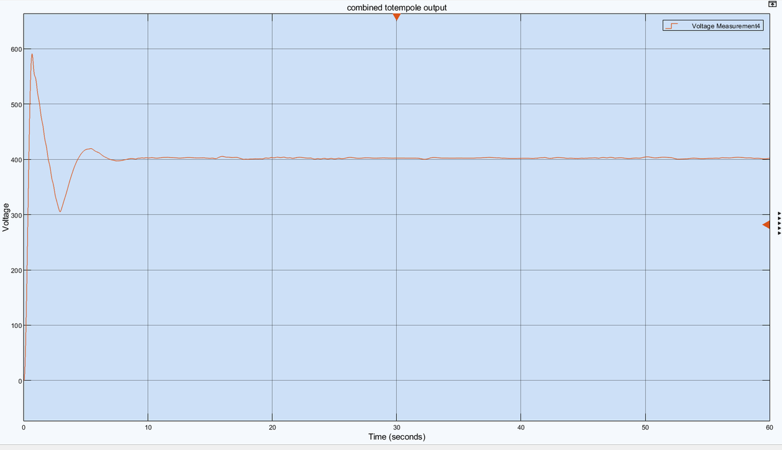
VI
Result and Discussion:
Output for combined circuits:
For the voltage output at the toem pole pfc circuit side:
We receive a constant 400V at the totem pole side and this value does not drop with time as it is maintained with the help of a closed loop control system which was not the case at the dab side so to maintain constant voltage we use a closed loop system at dab side too.
39

Slide 40
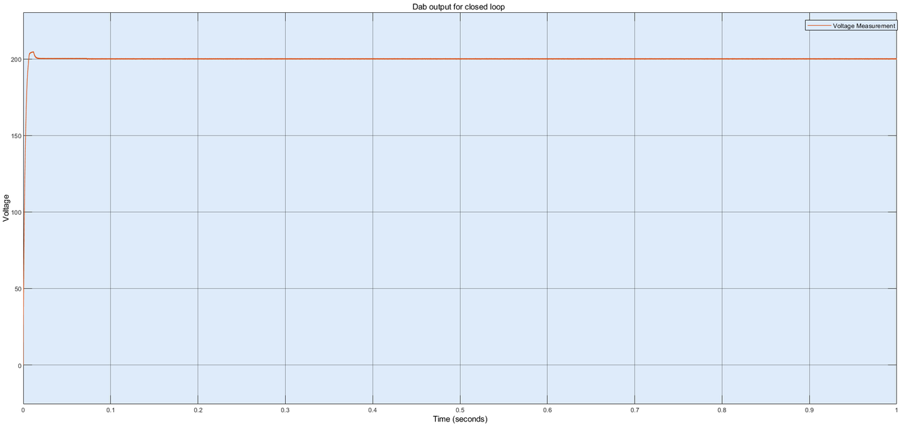
VI
Result and Discussion:
Output for individual circuit closed loop DAB:
For the voltage output at the dual active bridge converter side:
Voltage is maintained at around 200V which is as desired.
40

Slide 41
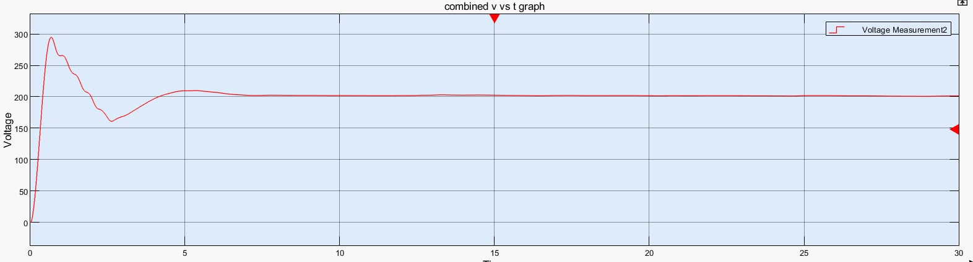
VI
Result and Discussion:
Integration of DAB and Totem pole circuit with phase from the difference between output
voltage and constant value:
We have obtained following output with this type of circuit, one of the advantage of using this is that the
voltage level does not drop even at the higher simulation as it did in the open loop model and voltage
is maintained constant at value around 201 Volts. This model was also found be compatible with higher
switching frequencies and had flexible switching option.
41

Slide 42
VI
Result and Discussion:
Possible sources of mistake:
• Incorrect phase shift:Providing correct phase shift becomes critical in the DAB converters as if the
provided phase shift is small the power that is supplied decreases and if it is too large there can exist excessive current flow which might result in high conduction losses.
• Incorrect switching frequencies:Choosing correct switching frequencies is also essential in these
type of circuits as the incorrect switching frequencies may result in voltage instability, incorrect
core sizes and efficiency issues.Though in our project we have primarily used a 20 KHZ switching
frequency to maintain a appropriate voltage level, this might not be the case in all the designs as the
switching frequency we choose also depends upon the sophistication of the control mechanism as well.
• Incorrect selection of parameters:Though calculation of parameters holds for individual circuit
design, while integrating different circuits its necessary to reevaluate different circuit parameters
based on the output received and in course of reevaluation there is possibility of incorrect parameter
selection which may also result in the incorrect performance of the system.
42

Slide 43
VI
Result and Discussion:
Challenges and Limitations:
Challenges:
Managing high-frequency switching noise, which can affect system stability and EMI performance.
Balancing efficiency and output voltage quality in both Totem Pole PFC and DAB converter designs.
Limitations:
Results are limited to MATLAB simulation without experimental hardware validation.
Focused on a two-stage on-board charger circuit, not exploring newer single-stage topologies.
Some real-world effects like parasitic elements and switching losses are not fully captured.
43

Slide 44
Conclusion and Recommendations:
Chapter VII
On board chargers using totem pole pfc and dab circuit
44

Slide 45
VII
Conclusion:
Conclusion:
At end of the project:
We successfully implemented Totem Pole PFC with 400V output
We achieved implementation of DAB converter with the output voltage 200V
Integrated both the circuits to create on board charging circuit topology with stable voltage.
Key highlights of the project:
Highlights the importance of use of correct phase shift for dual active bridge converter.
Highlights direction for design of on-board charging topology and leaves room for future hardware implementation.
Discusses various circuit topologies that can be used for design of OBC system.
Provides direction for future research on use of switching frequencies to balance voltage level.
45

Slide 46
VII
Conclusion:
Recommendation for further continuation of the project:
At end of the project:
We recommend the further research to focus on single stage OBC circuit integrating both totem pole and dab in a single stage circuit.
Implementation of hardware circuits based on current design and improvement on current design with hardware testing.
We recommend highlighting a deeper relation between phase shift and output voltage such. ANN based calculation can be performed for phase shift calculation.
46

Slide 47
References:
Chapter VIII
On board chargers using totem pole pfc and dab circuit
47

Slide 48
VIII
References
[1]. S. Khan, S. Sathyan, H. Sugali, and S. S. Chandra Bommagani, “Design of on-board battery
charger using interleaved bridgeless type pfc and phase shifted full bridge converter,” in 2020 IEEE
International Students’ Conference on Electrical,Electronics and Computer Science (SCEECS), 2020,
pp. 1–5.
[2] A. K. Singh, A. K. Mishra, K. K. Gupta, and T. Kim, “Comprehensive review of nonisolated bridgeless
power factor converter topologies,” IET Circuits, Devices Amp; Systems, vol. 15, pp. 197–208, 2021.
[3] E. Network, “A comparison of interleaved boost and totem-
pole pfc topologies,” EDN, 2025. [Online]. Available: https:
//www.edn.com/a-comparison-of-interleaved-boost-and-totem-pole-pfc-topologies/?fbclid=
IwY2xjawImIaVleHRuA2FlbQIxMAABHSUxXUnO5GSOGUTTPXGTOQRbuDPqmWQ3InHB4ffOxnnCKlR
aem a1Emh dB2O8x7FLmjHiWZg
[4] B. Zhao, Q. Song, W. Liu, and Y. Sun, “Overview of dual-active-bridge isolated bidirectional dc–dc
converter for high-frequency-link power-conversion system,” IEEE Transactions on Power Electronics,
vol. 29, no. 8, pp. 4091–4106, 2014.
[5] B. Kumar, A. Kumar, A. Bhat, and P. Agarwal, “Comparative study of dual active bridge isolated
dc to dc converter with single phase shift and dual phase shift control techniques,” in 2017 Recent
Developments in Control, Automation and Power Engineering, RDCAPE 2017, ser. 2017 Recent
Developments in Control, Automation and Power Engineering, RDCAPE 2017. United States:
Institute of Electrical and Electronics Engineers Inc., May 2018, pp. 453–458, publisher Copyright:
© 2017 IEEE.; 2017 Recent Developments in Control, Automation and Power Engineering, RDCAPE
2017 ; Conference date: 26-10-2017 Through 27-10-2017.
[6] W. Qiufeng, X. Yong, and Z. Xiangwen, “Research and design of control strategy for on-board charging
system in electric vehicle,” in 2017 29th Chinese Control And Decision Conference (CCDC), 2017, pp.
6901–6905.
[7] E. Firmansyah, S. Tomioka, S. Abe, M. Shoyama, and T. Ninomiya, “An interleaved totem-pole power
factor correction converter,” in Proceedings of the 15th International Power Electronics and Motion
Control Conference (EPE-PEMC), 2010, pp. 1298–1303.
48

Slide 49
Electrical Engineering Department, IOE Pulchowk
Thank you for
listening
49

